Slide 1
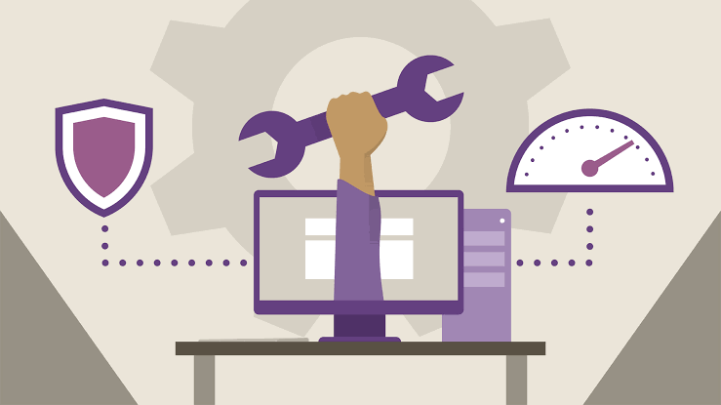
SOFTWARE MAINTENANCE
1
Software Maintenance

Slide 2
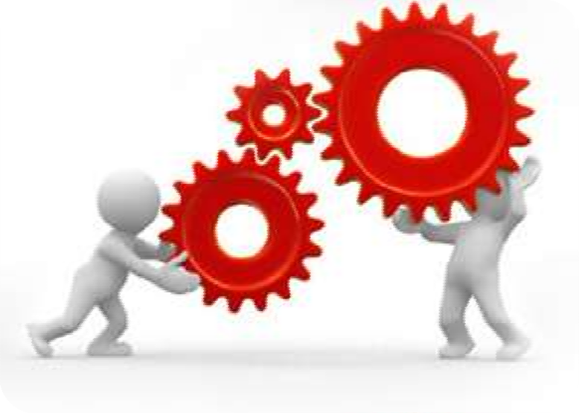

What is software maintenance?
2
Software maintenance
is the
modification of a software product after delivery to correct faults, to improve performance or other attributes.
A common
perception of
maintenance is
that it merely
involves fixing defects.
Software maintenance is the general process of changing a system after it has been delivered.

Slide 3
Software maintenance is a part of the Software Development Life Cycle.
Its primary goal is to modify and update software application after delivery to correct errors and to improve performance.
Software is a model of the real world.
When the real world changes, the software require alteration wherever possible.
Software Maintenance is an inclusive activity that includes error corrections, enhancement of capabilities, deletion of obsolete capabilities, and optimization.

Slide 4


Reasons for maintaining software
3
S O F T W A R E
Over a
period
of time
software’s requirement may
original change to
reflect the customer’s needs.
M A I N T E N A N C E
Errors undetected
during
software development may be found during use and require correction.
With time new technologies are introduced such as new hardware, operating system etc.

Slide 5
Reasons for maintaining software
Market Conditions - Policies, which changes over the time, such as taxation and newly introduced constraints like, how to maintain bookkeeping, may trigger need for modification.
Client Requirements - Over the time, customer may ask for new features or functions in the software.
Host Modifications - If any of the hardware and/or platform (such as operating system) of the target host changes, software changes are needed to keep adaptability.
Organization Changes - If there is any business level change at client end, such as reduction of organization strength, acquiring another company, organization venturing into new business, need to modify in the original software may arise.

Slide 6
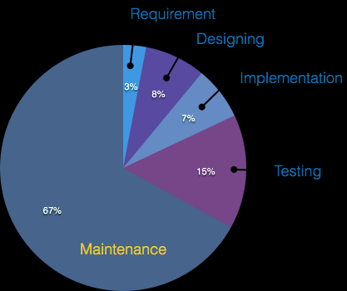
Cost distribution of SDLC
4

Slide 7
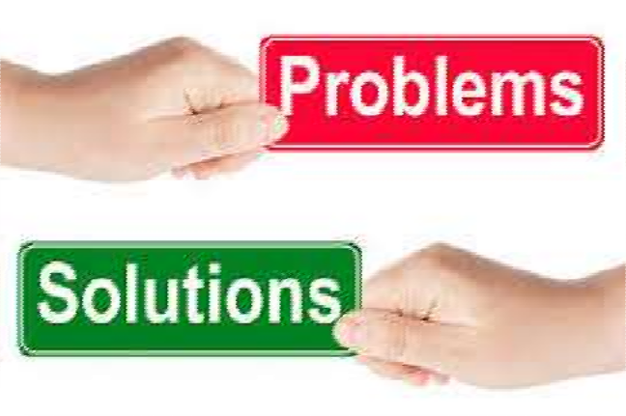

Software Maintenance Problems
5
Most
computer
programs are
difficult and expensive to maintain.
Software changes
are poorly
designed and implemented.
The repair
and enhancement of
software often injects new bugs that must later be repaired.
Changes are often not documented.
Changes often cause new faults in the system.

Slide 8
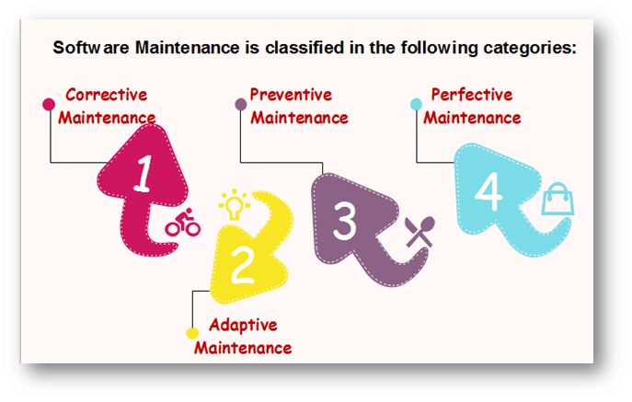
Types o software maintenance

Slide 9
Types of software maintenance
6
1. Corrective maintenance
Bug Fixing
2. Adaptive maintenance
Porting & Migration
3. Perfective maintenance
Enhancements & scalability
4. Preventive maintenance
Documentation Enhancements

Slide 10
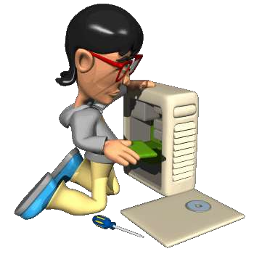
1. Corrective Maintenance
7
Taking existing code and correcting a fault that causes the code to behave in some way that deviates from its documented requirements.
Focuses
on bug fixing and
reporting errors fixing.
i.e. defects generally need to be corrected either immediately or in
the near future.
Fixing a fault has 20 to 50 % chances of introducing another fault.

Slide 11
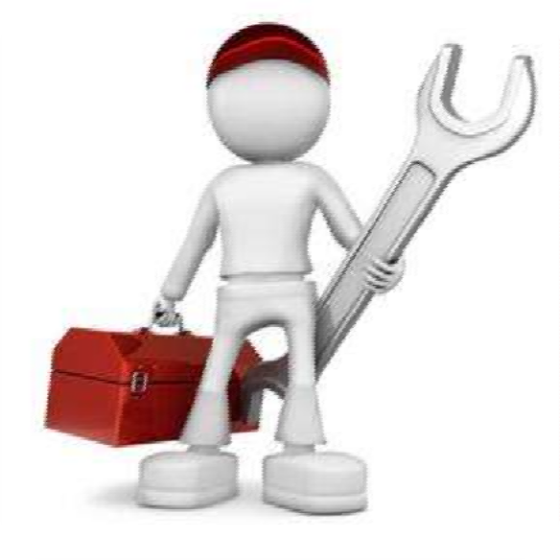

2. Adaptive Maintenance
8
Taking existing code and
adapting it to provide new
features and functionality. These
are typically part of a new release of the code and part of a larger development effort.
Making changes in existing
software to accommodate a
changing environment
includes all work related to how the software functions.
i.e. relates to enhancing
software functionality.

Slide 12
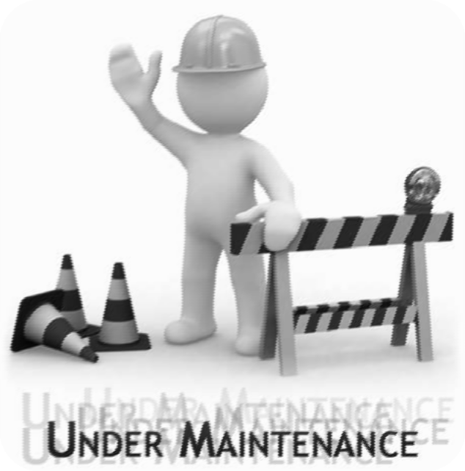

3. Perfective Maintenance
9
Implementing new or changed
user requirements which
concern functional
enhancements to the software.
These are typically made to
improve the maintainability of
the code such as restructuring it
to make it more easily
understood or to remove ambiguities.
includes all efforts to improve the quality of the software.
Includes improving reliability or efficiency.

Slide 13
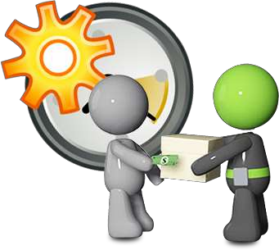
4. Preventive Maintenance
10
Includes
problems and
anticipating
future
to improve the
maintainability using techniques
like documenting, commenting or even re-implementing some part of documenting.
More commonly
known as
Software Re-engineering.
Old system
starts as a
specification for new system.
increasing the system’s maintainability.

Slide 14
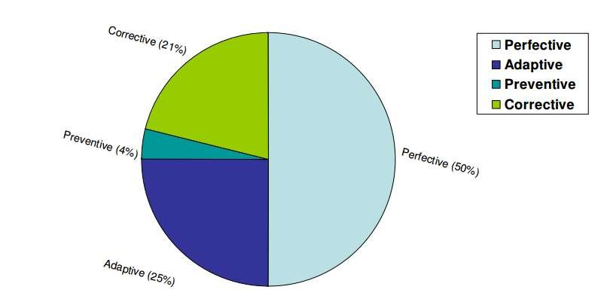
Cost of software maintenance
11

Slide 15
Software Maintenance models
12
Quick-fix model
Iterative Enhancement model
Full-reuse model
Boehm’s Model
Taute’s model

Slide 16
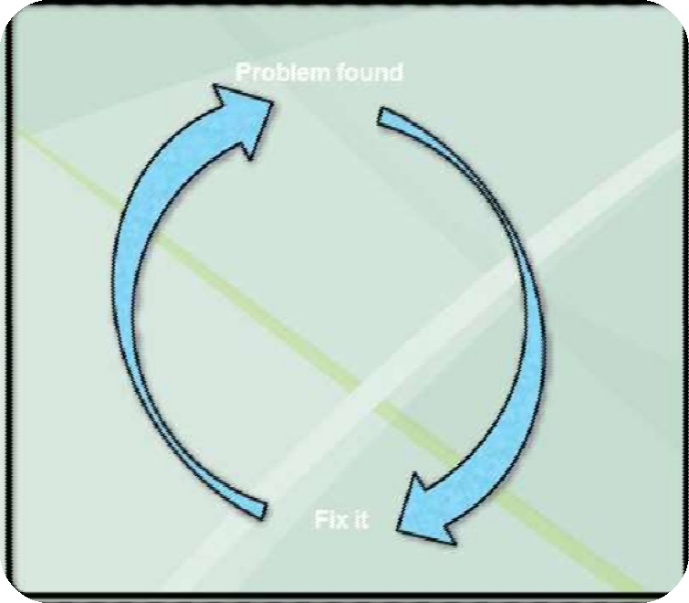

1. Quick-fix Model
13
S O F T W A R E
This is basically an adhoc approach to maintaining software. It is a fire fighting approach, waiting for the problem to occur and then trying to fix it as quickly as possible.
Changes are made at code level as early as possible without anticipating future problems.
As a result, the structure of software degrade rapidly.
Not suitable for large software systems.
M A I N T E N A N C E

Slide 17
2. Iterative Enhancement Model
14
Incorporates changes in the software based on the analysis of the existing system.
Assumes complete documentation of software is available in beginning.
Attemps to control complexity and tries to maintain good design.
The document of each software life cycle phase i.e SRS, design document, testing document etc. are also modified.

Slide 18
3. Full-reuse Model
16
Based on reuse of existing software components.
The reuse model has four main steps:
1.
Identification of the parts of the old system that are
candidates for reuse.
2.
Understanding these system parts.
3.
Modification of the old system parts appropriate to the new requirements.
4.
Integration of the modified parts into the new system.
Need mature reuse culture.
Software Maintenance

Slide 19
3. Full-reuse Model(cont.)
17
Old system
New system
Requirements analysis
Requirements analysis
Design
Components library
Design
Source code
Source code
Test data
Test data

Slide 20
4. Taute Maintenance Model
19
It is straightforward, practical and easy to understand.
It is used by developers for updating and performing modification in the software after its execution in the system.
However, to better understand Taute Maintenance Model, it is essential to know more about Software Maintenance.
Taute Maintenance Model is divided into eight phases which appear in cycle fashion.
These phases are:

Slide 21
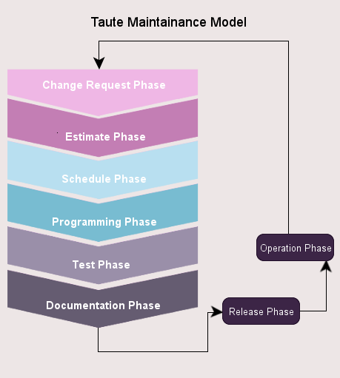
4. Taute Maintenance Model
20
S O F T W A R E
M A I N T E N A N C E

Slide 22
Change Request Phase: : In this phase request to implement changes and modifications is requested by the client, which is provided in a prescribed format. This requested change can fall in any category of maintenance activities.
Estimate Phase: Here the team is devoted in estimating the time and effort required to make the requested changes. Impact analysis on existing system is also required to minimize the ripple effect.
Schedule Phase: During this stage the team identifies the change request for the next scheduled release and prepare the documents that are required for planning.

Slide 23
Programming Phase: the source code is modified to implement the requested change. Moreover, all relevant documents, like design document, manuals, etc. are updated accordingly. The final output of this stage is the test version of the source code
Test Phase: The modifications and updates required in the software are carefully implemented in this phase. The code is tested using available as well as new test cases.
Documentation Phase: After regression testing, system and user documents are prepared and updated before release. By doing so, the developers are able to maintain co-relation between code and documents.

Slide 24
Release Phase: The new software product along with updated documents are delivered to the customer. Acceptance Testing is carried out by the users of the system.
Operation Phase: Once the acceptance testing is successfully implemented, software is placed under normal operation. During usage, when another problem is identified or new functionality requirement is felt or even the enhancement of existing capability is desired, again a ‘change request’ process is initiated.

